Slide 1
Head and Neck Cancer Patient Survival Prediction
Team Member: Hongtai Du, Daniel Yang

Slide 2
Models
Criteria | Logistic Regression | SVM | Neural Network
Model Type | Linear Model | Non-linear (via kernels) | Non-linear, Multi-Layered
Assumption | Assumes linear decision boundary | No assumption about data shape | No assumption about data shape
Handles Non-Linearity | Poor (Linear decision only) | Excellent (with RBF kernel) | Excellent
Handles Small Data | Very good | Very good | Bad
Performance | Moderate (linear data) | Strong (non-linear data) | Very Strong

Slide 3
Data
The dataset was obtained from SEER*Stat for Head and Neck Cancer patients, containing 26,319 rows after filtering. Key features included:
Demographic Features: Age, Sex, Race, Year of Diagnosis.
Clinical Features: Combined Summary Stage, Primary Site, Chemotherapy, Radiation, CS Tumor Size, CS Lymph Nodes.
Target Variable: “Vital Status Recode” (“Alive” or “Dead”).

Slide 4
Data
Age | Sex | Year of diagnosis | Race | Primary Site | Histologic Type ICD-O-3 | Combined Summary Stage (2004+) | Surgery of oth reg/dis sites (1998-2002) | Chemotherapy | Radiation recode | Vital status recode (study cutoff used) | Survival months | SEER cause-specific death classification | Tumor Size Summary (2016+) | EOD Primary Tumor (2018+) | CS lymph nodes (2004-2015) | CS tumor size (2004-2015)
40-44 years | Male | 2002 | White | 629 | 9061 | Blank(s) | 0 | No/Unknown | Beam radiation | Alive | 232 | Alive or dead of other cause | Blank(s).1 | Blank(s).2 | Blank(s).3 | Blank(s).4
65-69 years | Male | 2000 | White | 209 | 8140 | Blank(s) | 0 | No/Unknown | None/Unknown | Dead | 49 | Dead (attributable to this cancer dx) | Blank(s) | Blank(s) | Blank(s) | Blank(s)
35-39 years | Female | 2008 | White | 199 | 8140 | Distant | Blank(s) | Yes | Beam radiation | Alive | 167 | Alive or dead of other cause | Blank(s) | Blank(s) | 100 | 35
60-64 years | Female | 2008 | White | 381 | 8801 | Localized | Blank(s) | No/Unknown | None/Unknown | Dead | 0 | Dead (attributable to this cancer dx) | Blank(s) | Blank(s) | 0 | 90
Notes:
Total of 8.8 millions case, we took 1000000 data for training
This is a example visof how the data looks like

Slide 5
Preprocessing
Handling Missing Values: Replaced placeholders like “Blank(s)” and “No/Unknown” with NaN, then filled with zeros or “Unknown.”
Encoding Categorical Variables: Used one-hot encoding for categorical features (e.g., Sex, Race, Radiation).
Scaling Numerical Features: Standardized numerical columns (e.g., Age, Tumor Size) using StandardScaler.

Slide 6
Loss Function
Logistic Regression: (Binary Cross-Entropy)
Loss = 0.5217
SVM: (Hinge Loss)
Loss = 0.5728
Neural Network: (Categorical Cross-Entropy)
Loss = 1.5914

Slide 7
Training Procedure
Logistic Regression: Trained using a linear solver with max iterations of 1,000.
SVM: Used an RBF kernel to model non-linear relationships, with hyperparameters C=1.0 and gamma=‘scale.’
Neural Network: Multi-layer perceptron with two hidden layers (128, 64), “relu” activation, and Adam optimizer.
Data Split: 80% training, 20% testing for all models.

Slide 8
Logistic Regression
Accuracy: 0.7388 (73.88%)
The model correctly predicted 73.88% of the survival outcomes.
Confusion Matrix:
[[1912 668]
[ 707 1977]]
True Negatives (TN): 1,912 → Correctly predicted Alive.
False Positives (FP): 668 → Predicted Dead, but actually Alive.
False Negatives (FN): 707 → Predicted Alive, but actually Dead.
True Positives (TP): 1,977 → Correctly predicted Dead.
Classification Report:
Metric | Class 0 (Alive) | Class 1 (Dead)
Precision | 0.73 | 0.75
Recall | 0.74 | 0.74
F1-Score | 0.74 | 0.74
Notes:
1million data, around 26k head and neck cancer patient by filtering with primary site

Slide 9
SVM
Accuracy: 0.7456 (74.56%)
The model correctly predicted 74.56% of the survival outcomes.
Confusion Matrix:
[[1907 673]
[ 666 2018]]
True Negatives (TN): 1,907 → Correctly predicted Alive.
False Positives (FP): 673 → Predicted Dead, but actually Alive.
False Negatives (FN): 666 → Predicted Alive, but actually Dead.
True Positives (TP): 2,018 → Correctly predicted Dead.
Classification Report:
Metric | Class 0 (Alive) | Class 1 (Dead)
Precision | 0.74 | 0.75
Recall | 0.74 | 0.75
F1-Score | 0.74 | 0.75

Slide 10
Neural Network(Hidden Layer: 128, 64)
Accuracy: 0.7023 (70.23%)
The model correctly predicted 70.23% of the survival outcomes.
Confusion Matrix:
[[1745 835]
[ 732 1952]]
True Negatives (TN): 1,907 → Correctly predicted Alive.
False Positives (FP): 673 → Predicted Dead, but actually Alive.
False Negatives (FN): 666 → Predicted Alive, but actually Dead.
True Positives (TP): 2,018 → Correctly predicted Dead.
Classification Report:
Metric | Class 0 (Alive) | Class 1 (Dead)
Precision | 0.70 | 0.70
Recall | 0.68 | 0.73
F1-Score | 0.69 | 0.71
Notes:
Each additional layer adds complexity, increasing the risk of overfitting with smaller datasets.

Slide 11
Neural Network(Hidden Layer: 64, 32)
Accuracy: 0.7008 (70.08%)
The model correctly predicted 70.08% of the survival outcomes.
Notes:
With less complex model, the accuracy is even lower, so skip it

Slide 12
Result Comparison
Model | Strengths | Weakness
Logistic Regression | Simple, interpretable, balanced performance | Cannot model non-linear relationships
SVM | Best accuracy, captures non-linear patterns | Computationally expensive
Neural Network | Capable of learning complex patterns | Requires more data, lower performance

Slide 13
Detail Comparison
Metric | Logistic Regression | SVM | Neural Network
Accuracy | 73.88% | 74.56% | 70.23%
Precision (0) | 0.73 | 0.74 | 0.70
Precision (1) | 0.75 | 0.75 | 0.70
Recall (0) | 0.74 | 0.74 | 0.68
Recall (1) | 0.74 | 0.75 | 0.73
F1-Score (0) | 0.74 | 0.74 | 0.69
F1-Score (1) | 0.74 | 0.75 | 0.71

Slide 14
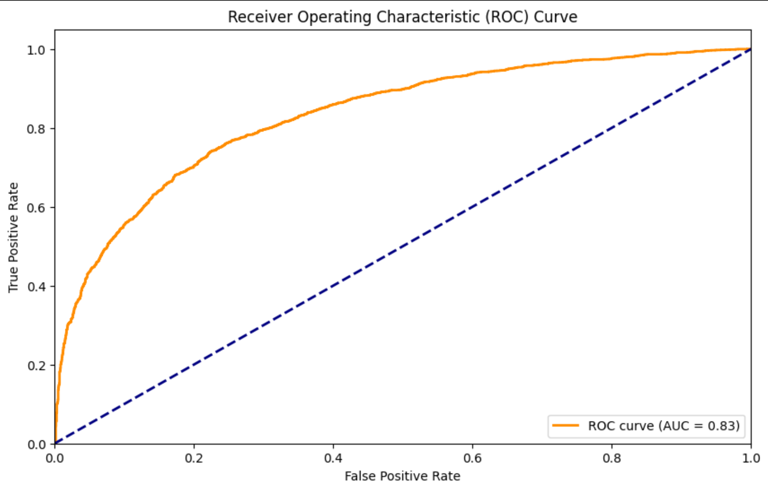
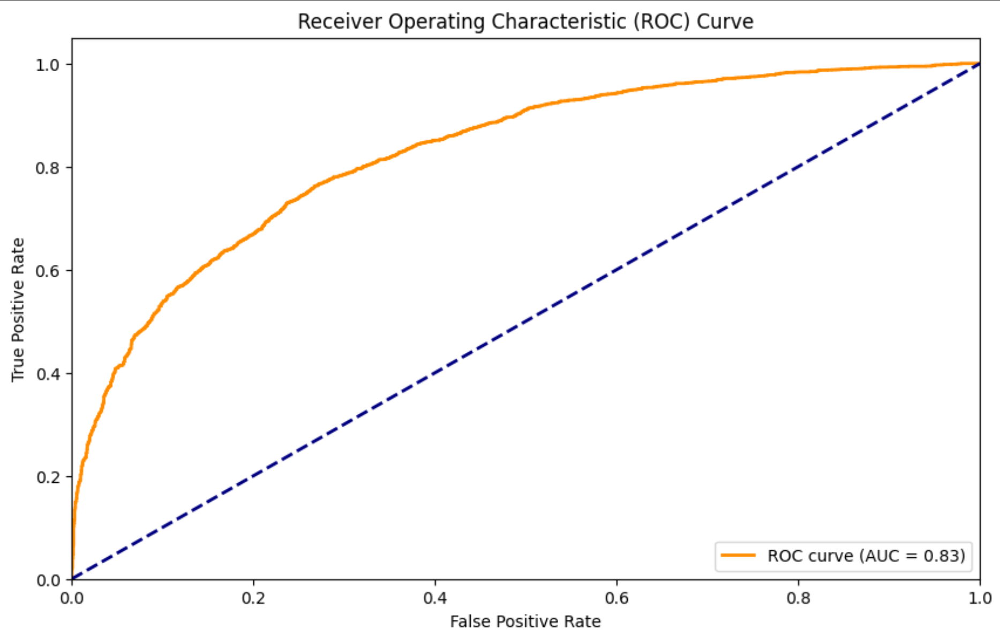
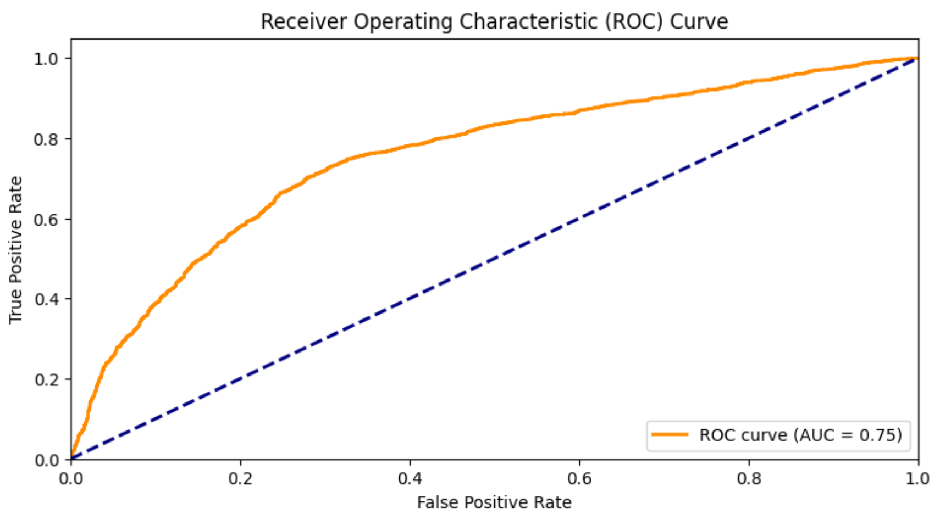
ROC curve and AUC Score each model
AUC = 0.83
AUC = 0.83
AUC = 0.83
AUC = 0.75
Logistic regression
SVM
Neural network

Slide 15
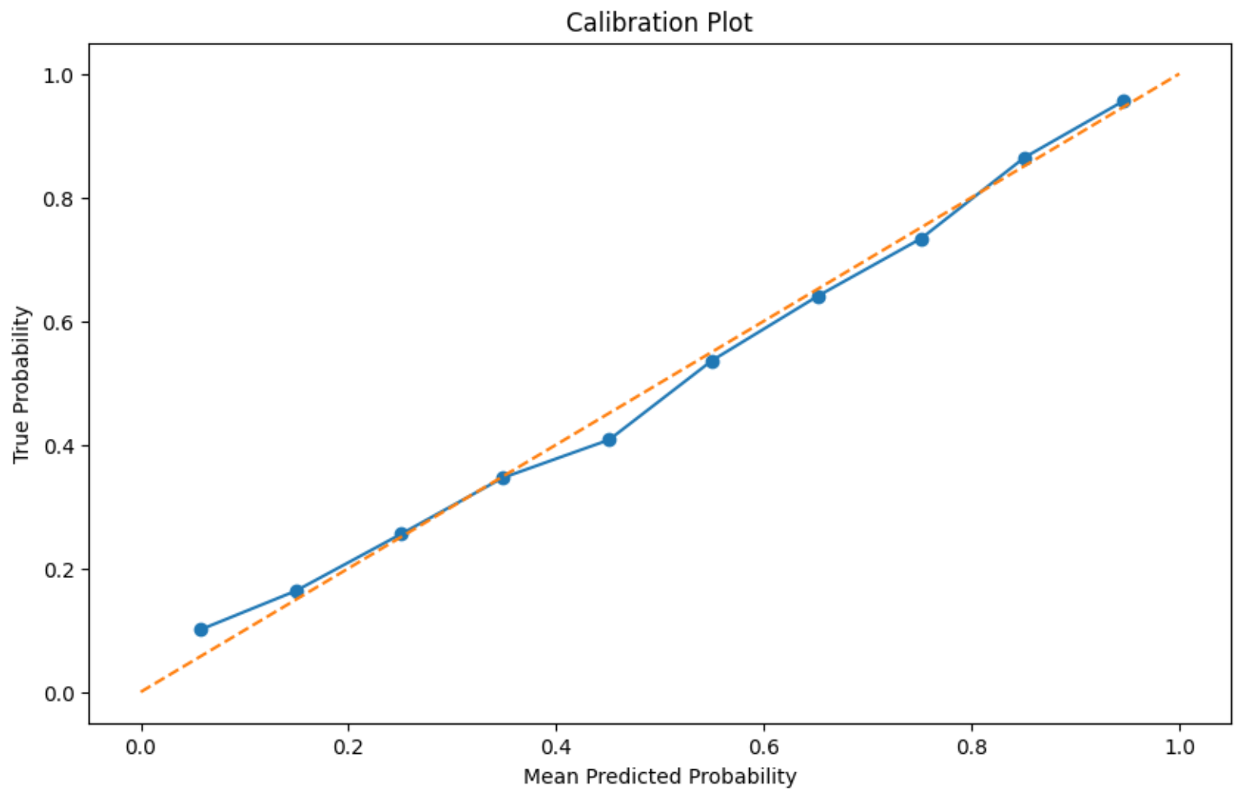
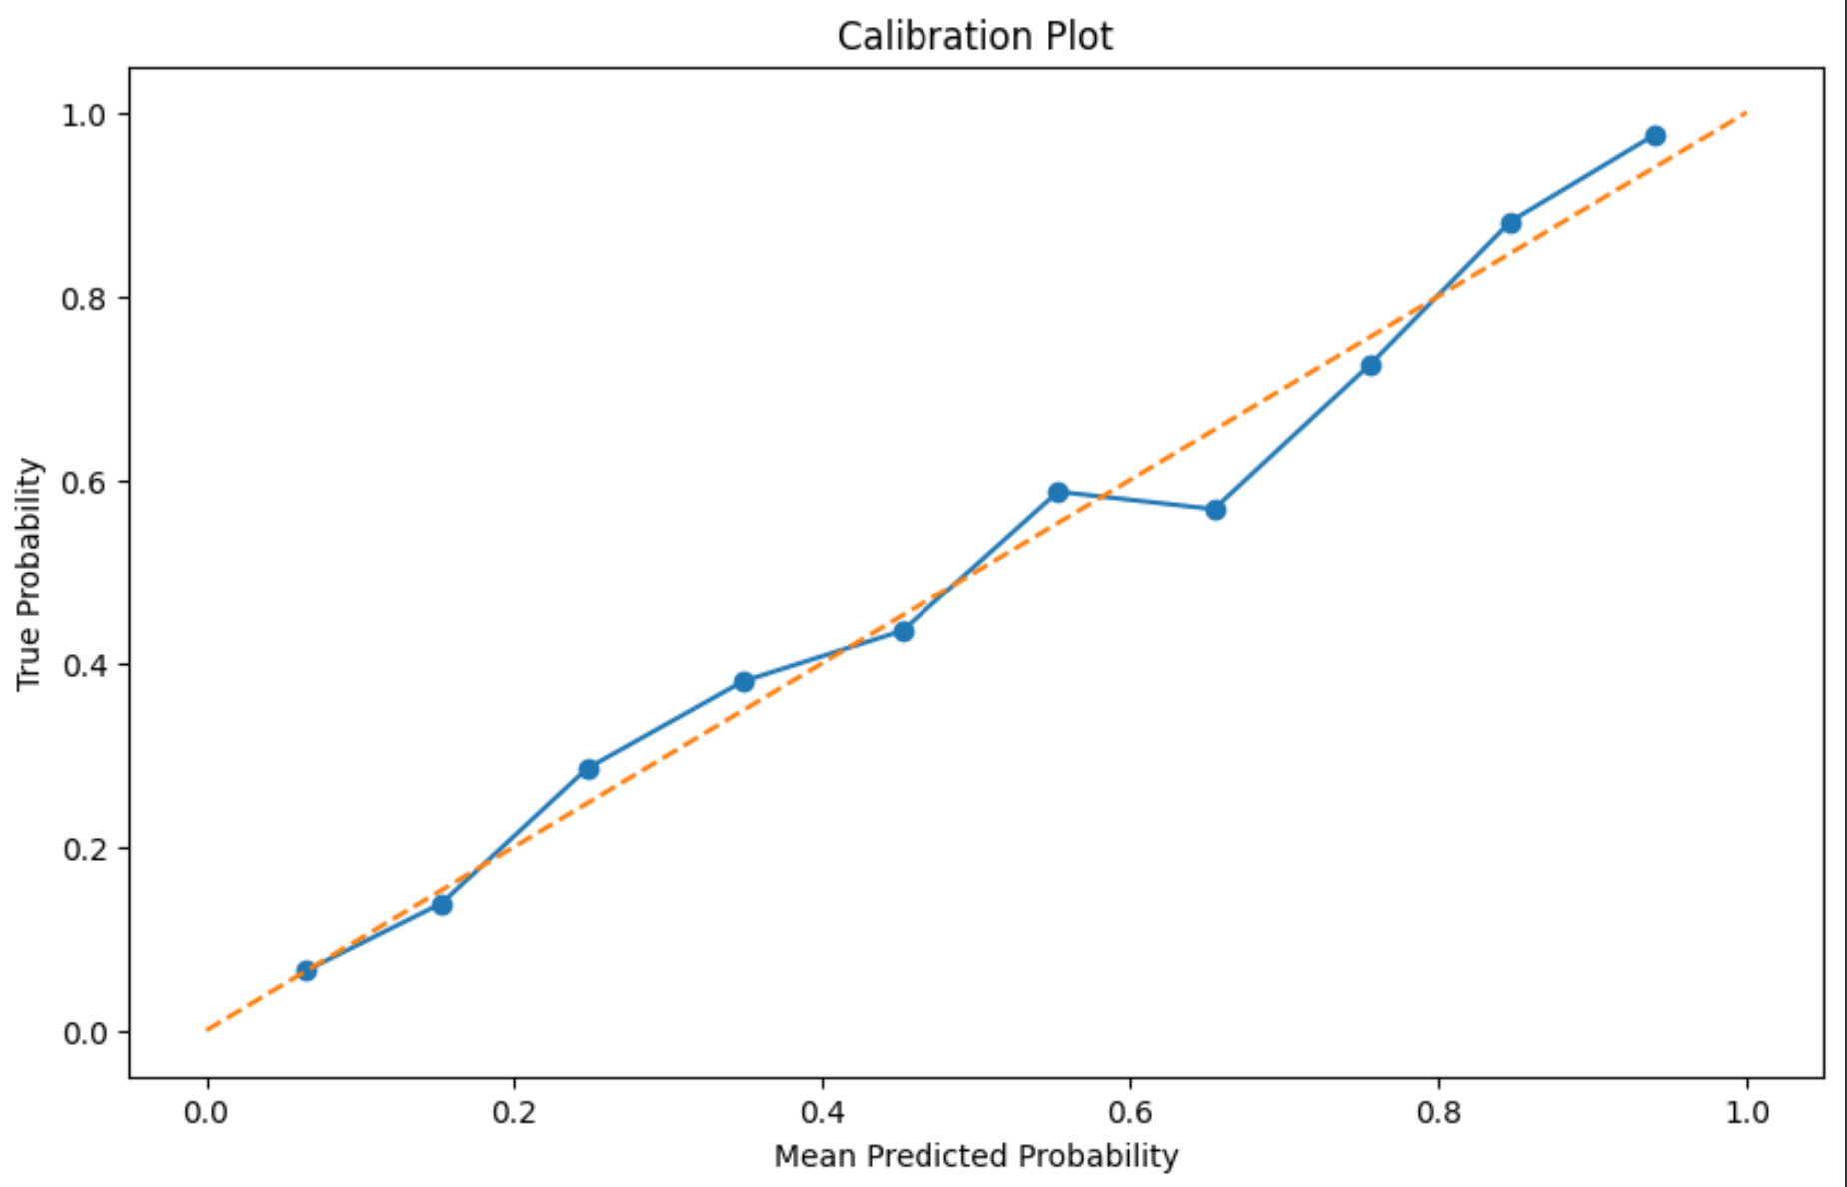
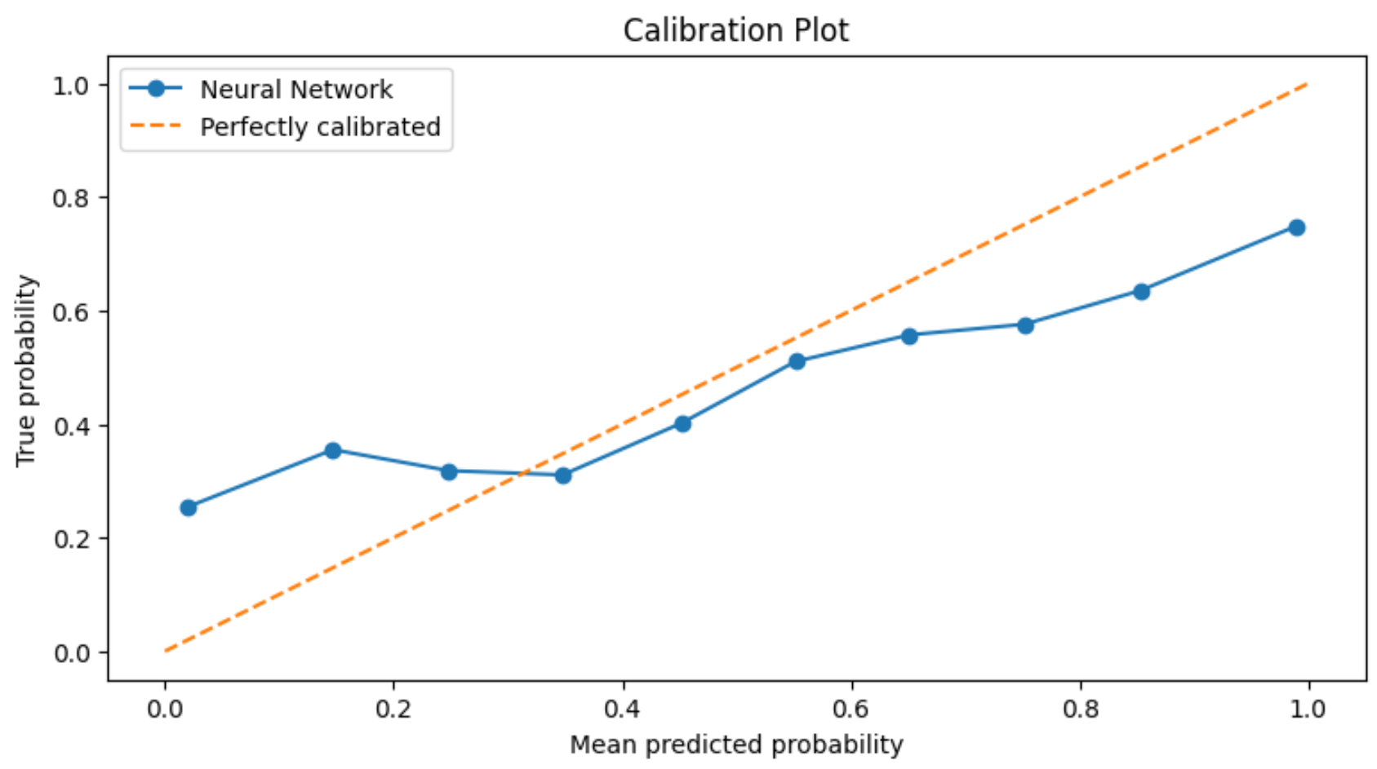
Calibration plot each model
Neural network
Logistic regression
SVM
Neural network

Slide 16
Limitations and improvements:
1. Need more significant attributes about cancer that influences survival rate
2. Apply cross-validation to enhance robustness of model.
3. Refine code to improve accuracy.

Slide 17
Thank you :)

